Slide 1

DRONACHARYA BAHUUDDESHIYA SANSTHA Reg. No. Maha. 272/10 Devmali, Achalpur, Dist : Amravati

Slide 2
Introduction
Empowering Dreams: Dronacharya Bahuuddeshiya Sanstha
Established in 2010, Dronacharya Bahuuddeshiya Sanstha is a non-profit organization with a noble mission. Beyond the local twin cities, our vision extends into the tribal regions nearby. Here, we strive to enhance the skills of tribal students, particularly in the art of archery.
At Dronacharya Bahuuddeshiya Sanstha, we aim to support aspiring students who dream of excelling in archery. Through our efforts, we seek to provide them with the necessary resources and guidance to soar to new heights in their chosen field.

Slide 3
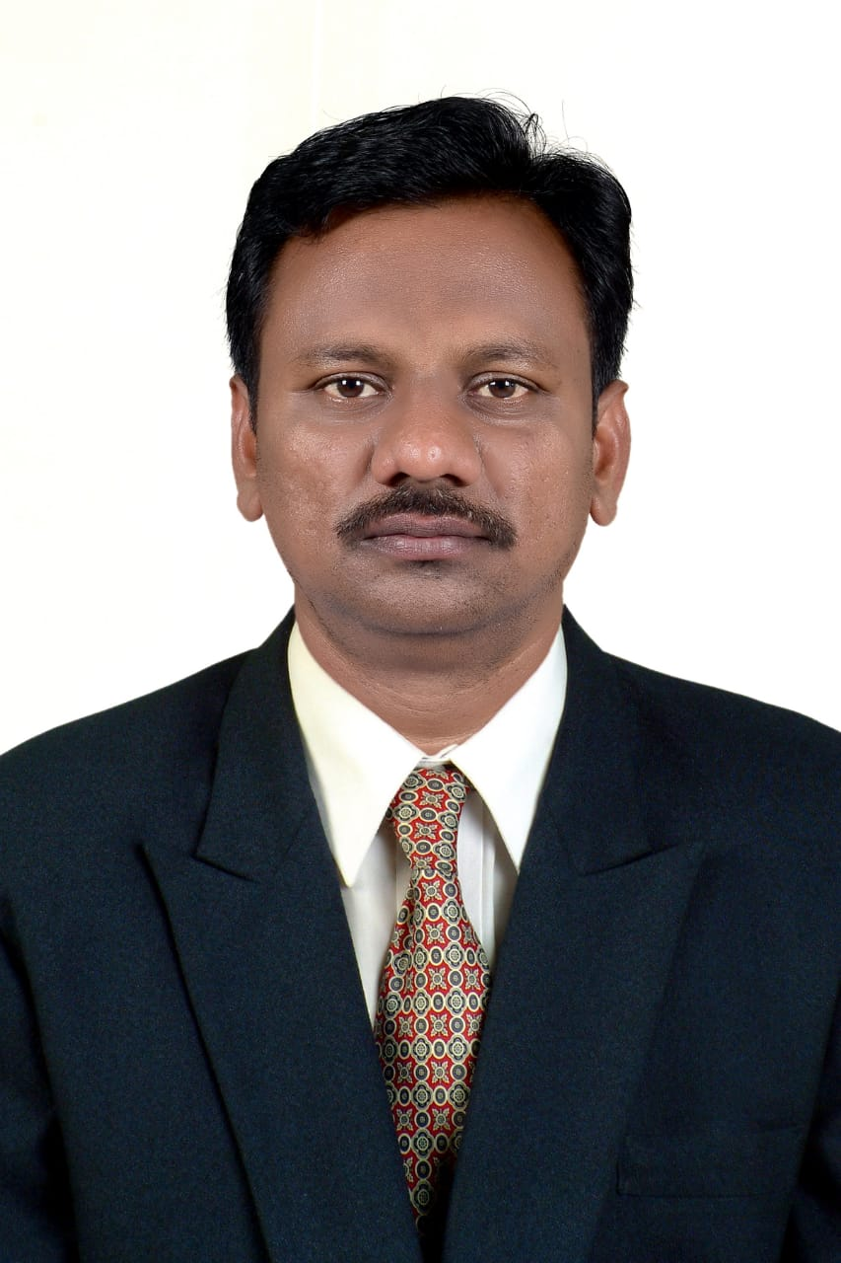
Sameer Mhaske(Head Coach)
Mr. Sameer Prabhakar Mhaske: National player of 2007 (Archery), now coach at D.B.S.
Coaching since 2009: Started coaching archery for free on nearby grounds.
Remarkable Results: Many students participated in district, national, and international archery competitions.
National Archery Coach: Selected as National Archery Coach for the 2020 Tokyo Olympic National camp in Pune.
Student Success: Shukmani Babrekar, Mr. Mhaske's student, selected for Tokyo Olympic National camp.
International Success: 7-8 players participated and won medals in international tournaments.
National Achievements: 30-40 players coached by Mr. Mhaske won medals in national level tournaments.

Slide 4
Assistant Coaches
Girish Kukade:
- National Judge: Holds the position of National Judge at the Archery Association of India.
- National Medal Archer: Achieved national medals as an archer.
- Coaching Start: Began coaching journey in 2017.
- Development of Players: Successfully coached players to become international and national medalists.
- Recent Success: Coached player Tushar Shelke to win a Silver Medal in the Asian Games held in China.
Akshay Tekade:
- Akshay: NIS Coach and National Medalist Player.
Coaching Start: Began coaching in 2018.
Affiliation: Currently working with Adaani Group of Tribal School in Gondia.
Shubham Nage:
- Shubham: NIS Coach and national Medalist Archer.
- Affiliation: Working in Vijaya Convent English School.

Slide 5
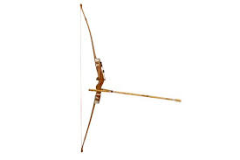
5 Year Plan of Dronacharya Archery Academy
There are Two type of Bow required for 5 year plan.
1)Indian Bow:
Indian Round Archery: Traditional type of archery made from
bamboo and wood.
Limited Scope: Played only in state and national tournaments
in India.
Accessibility: Bow available at a low cost, around 7 to 8 thousand rupees.
Measurement Issue: Bow specifications prevent participation in international formats.

Slide 6
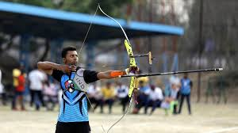
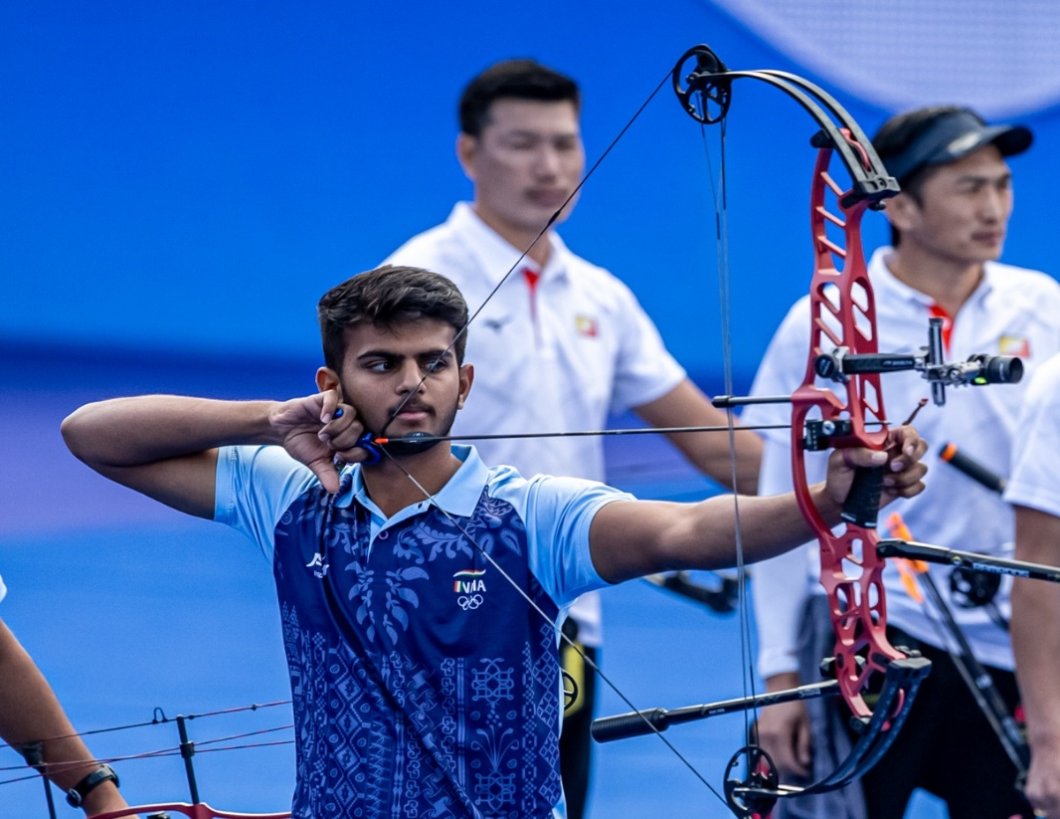
2)Recurve Bow:
Recurve Round Archery Bow: Constructed from carbon, graphene, and aluminum, all sourced from abroad.
International Participation: Played in prestigious international events including Olympic Games, World Championship, World Cup, Asian Games, and Commonwealth Games.
3)Compound Bow:
Compound Round Archery Bow: Constructed from carbon, graphene, and aluminum, all sourced from abroad.
International Participation: Played in prestigious international events including World Championship, World Cup, Asian Games, and Commonwealth Games.
Compound round bow is not allow in Olympics.

Slide 7
Implementation of Program
5-Year Plan: Begins with Indian Round bow training.
2-year Practice: Archers train exclusively with Indian Round bows for 2 Year.
Transition: Academy switches to Recurve Round Archery after 24 months.
Preparation for International Tournaments: After 1-2 years of training, archers are prepared for international competitions.
Motive of Dronacharya Bahuddeshiya Sanstha: To groom archers for success in international tournaments.

Slide 8
Description
Location: Melghat, a tribal area in Taluka Dharani, situated 150 kilometers away from Amravati city.
Ashram School: Houses around eight to ten thousand students aged 12 to 16 years.
Archery Training: Conducted by the organization to harness the potential of the students.
Track Record: Organization has previously produced numerous national and international players using similar training methods.
Accommodation and Food: Provided for students in the ashram school during training.
Tribal Sport: Archery holds cultural significance for tribes like Gond and Korku, serving as a means of livelihood.
Lack of Facilities: Despite the cultural importance, children in these areas lack facilities for archery.
Goal: Organization aims to tap into the latent talents of these children and groom them for national and international competitions.
Olympic Aspirations: Seeks to create a system and provide facilities for athletes to compete in upcoming Olympic Games.
Financial Assistance: Organization hopes to receive financial aid to support its endeavors and produce talented athletes.

Slide 9
Budget of 5-Year Training Plan
Equipment's:-
Sr.No | Particulers | For Time Period | No. Of Players | Estimate Amount
1 | Wooden Bow Kit(1lakh For maintenance) | 21-Month | 50 (Boys/Girls) | 500000
2 | Recurve Bow | 36-Month | 8 (Boys/Girls) | 3500000
3 | Compound Bow | 36-Month | 8 (Boys/Girls) | 3500000
 | Total |  |  | 7500000
Playing Kit & Diet
Sr.No | Particulers | For Time Period | No. Of Players | Estimate Amount
1 | T-shirt, Lower,Short,shoe | 1year | 50(Boys/Girls) | 100000
2 | Diet(As Per requirement) | 1year | 50(Boys/Girls) | Nill
3 |  |  |  | 100000

Slide 10
Coaches & Staff
Sr.No | Particulers | For Time Period | Amount | Yearly Amount
1 | Chief Coach | 1 Month | Nill | Nill
2 | Asst.Coach | 1 Month | 60000 | 720000
3 | Asst.Coach | 1 Month | 60000 | 720000
4 | Asst.Coach | 1 Month | 60000 | 720000

Slide 11
Total Expenses
 | Total Expenses of July-2024 – June-2025 | Amount
1 | Equipments & Maintainance | 500000
2 | Coaches & Staff | 2160000
3 | Playing Kit | 100000
 | Total | 2760000
 | Total Expenses of July-2025 – March-2026 | Amount
1 | Equipments & Maintainance | 100000
2 | Coaches & Staff | 1620000
3 | Playing Kit | 100000
 | Total | 1820000

Slide 12
Total Expenses
 | Total Expenses of April-2026 – March-2027 | Amount
1 | Equipment's Recurve Round Bow | 3500000
2 | Equipment's Compound Round Bow | 3500000
3 | Equipment's Maintanace Indian Round Bow | 100000
 | Coaches & Staff | 2160000
 | Playing Kit | 100000
 | Total | 9360000
The 2028 & 2029 spending plan will be based on the quality of players.
Because some ecpert people will be required in the staff like as:
Physio
Psychologist
Conditioner Trainer

